Slide 1
Anatomy and physiology of the nervous system
CLASS 3
Course: Psychophysiology I
Degree: Psychology
Prof. Verónica Espinoza

Slide 2

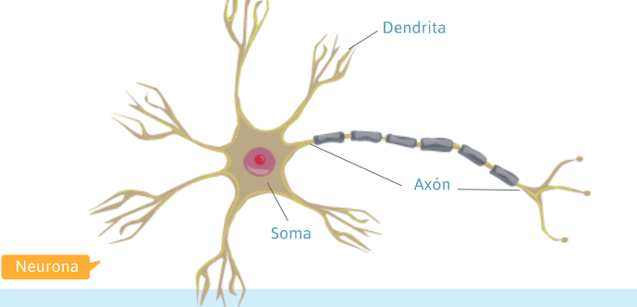
Neurons
Neurons are nerve cells, and three parts of them are identified:
1.- Soma:
Here, the nucleus, mitochondria, Golgi apparatus, and endoplasmic reticulum are found
2.-Dendrites:
They are branches extending from the cell body that allow the reception of impulses.
3.-Axon:
It is an extension of the cell body, which, unlike dendrites, is singular, thicker, and longer. The axon is responsible for conducting signals from the cell body to other neurons.

Slide 3
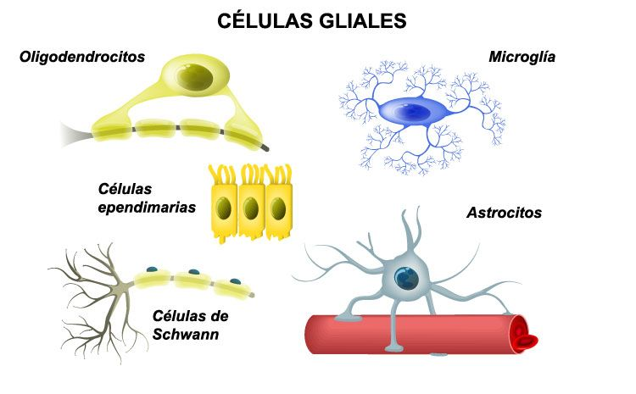
Glial Cells
The nervous system is not composed solely of neurons. Alongside neurons, the functional unit of the nervous system, we find glial cells (neuroglia or glia).
. Glial cells are:
1.-Astrocytes
2.-Ependymal cells
3.-Microglia
4.-Oligodendrocytes
5.-Schwann cells

Slide 4
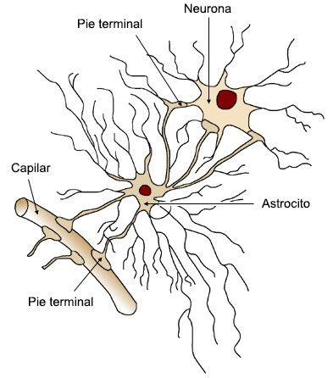

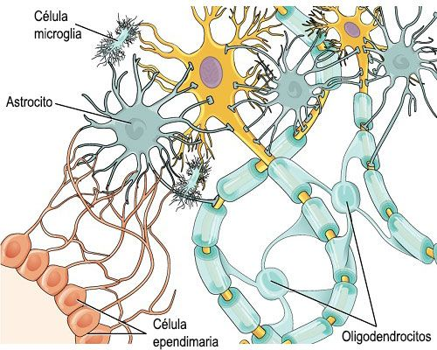
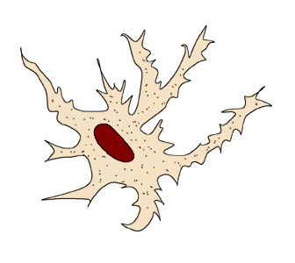
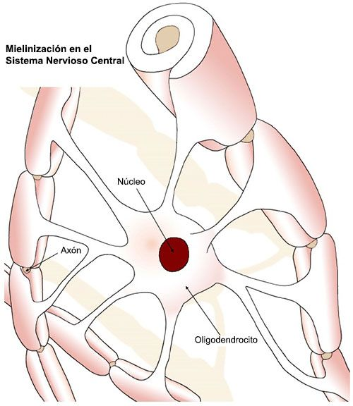
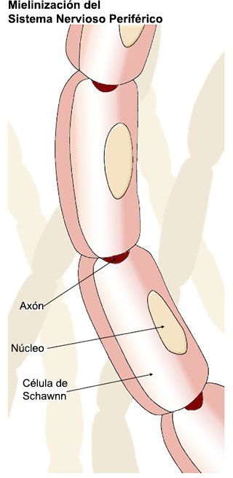
Glial Cells
1. ASTROCYTES These are the most abundant glial cells and are named for their star-like shape.
They are found in the brain and spinal cord.
2. EPENDYMAL CELLS: These are specialized cells that line the brain ventricles and the central canal of the spinal cord. They play an important role in the transport of hormones to the brain.
3. MICROGLIA: These are extremely small cells of the central nervous system that eliminate cellular waste and protect against microorganisms (bacteria, viruses, parasites, etc.).
4. OLIGODENDROCYTES: These are structures of the central nervous system that wrap around some neuronal axons to form an insulating layer known as the myelin sheath.
5. SCHWANN CELLS
In the peripheral nervous system (PNS), Schwann cells perform the same functions as the various glial cells of the CNS.

Slide 5
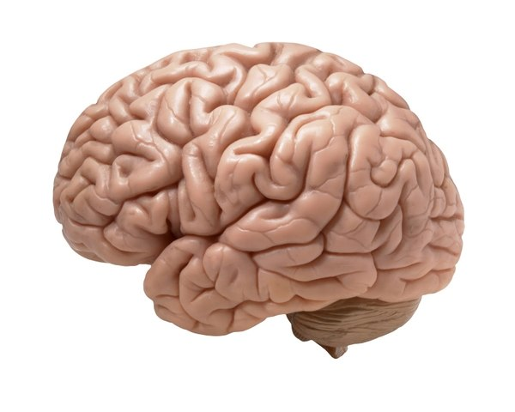
Main structures of the nervous system
The nervous system receives multiple stimuli and can simultaneously organize multiple responses.
THE BRAIN
The brain is divided into two parts called cerebral hemispheres, separated by a groove of white fibers called the corpus callosum.
It is responsible for:
cognition
the emotions
memory
learning

Slide 6
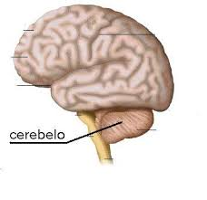
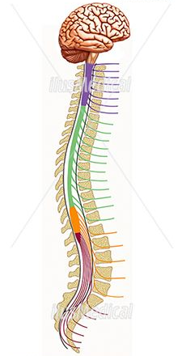
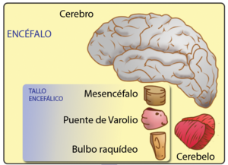
Main structures of the nervous system
THE CEREBELLUM
The cerebellum acts automatically (without conscious participation) in the coordination of movements.
It participates in maintaining balance.
It plays an important role in the body's posture.
THE BRAINSTEM
It is a structure composed of the midbrain, pons, and medulla oblongata.
This is a key region for heart rate and respiration, among other organic functions.
SPINAL CORD
It is the continuation of the encephalon. It is a conduit that connects the encephalon to the rest of the body, beginning in the occipital region and extending to the lumbar area.

Slide 7
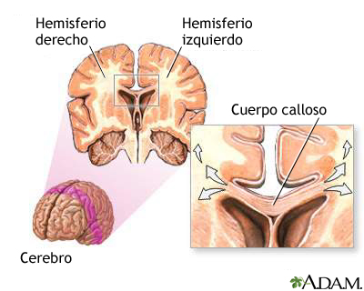
Cerebral hemispheres
What are the Cerebral Hemispheres?
Neuroscientists have divided the brain into two sections, parts or different hemispheres of the brain and separated by nerve fibers collectively called the \"corpus callosum\".
The corpus callosum manages to connect both hemispheres by crossing the midline and transmitting information from one side to the other.
These two hemispheres are called Left Hemisphere and Right Hemisphere.

Slide 8

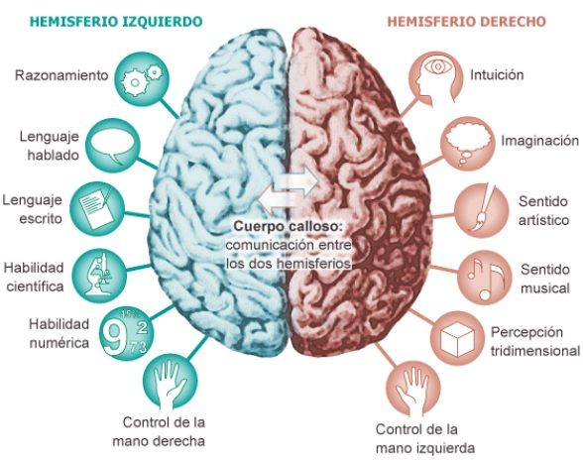

Cerebral hemispheres
The Left Hemisphere
Controls the right side of the body, that is opposite to where it is located.
It is responsible for arithmetic, logic and speech.
It is related to the verbal part, logical thinking, analyzes, abstracts, counts, measures time, plans step‑by‑step procedures, verbalizes.
The language, hearing and handwriting are related to this hemisphere.
The Right Hemisphere:
Controls the left side of the body and is related to the creativity, emotions and images (thinks and recalls images).
It is specialized in sensations, feelings and special visual and auditory abilities, such as music or art, but not verbal.

